Slide 1
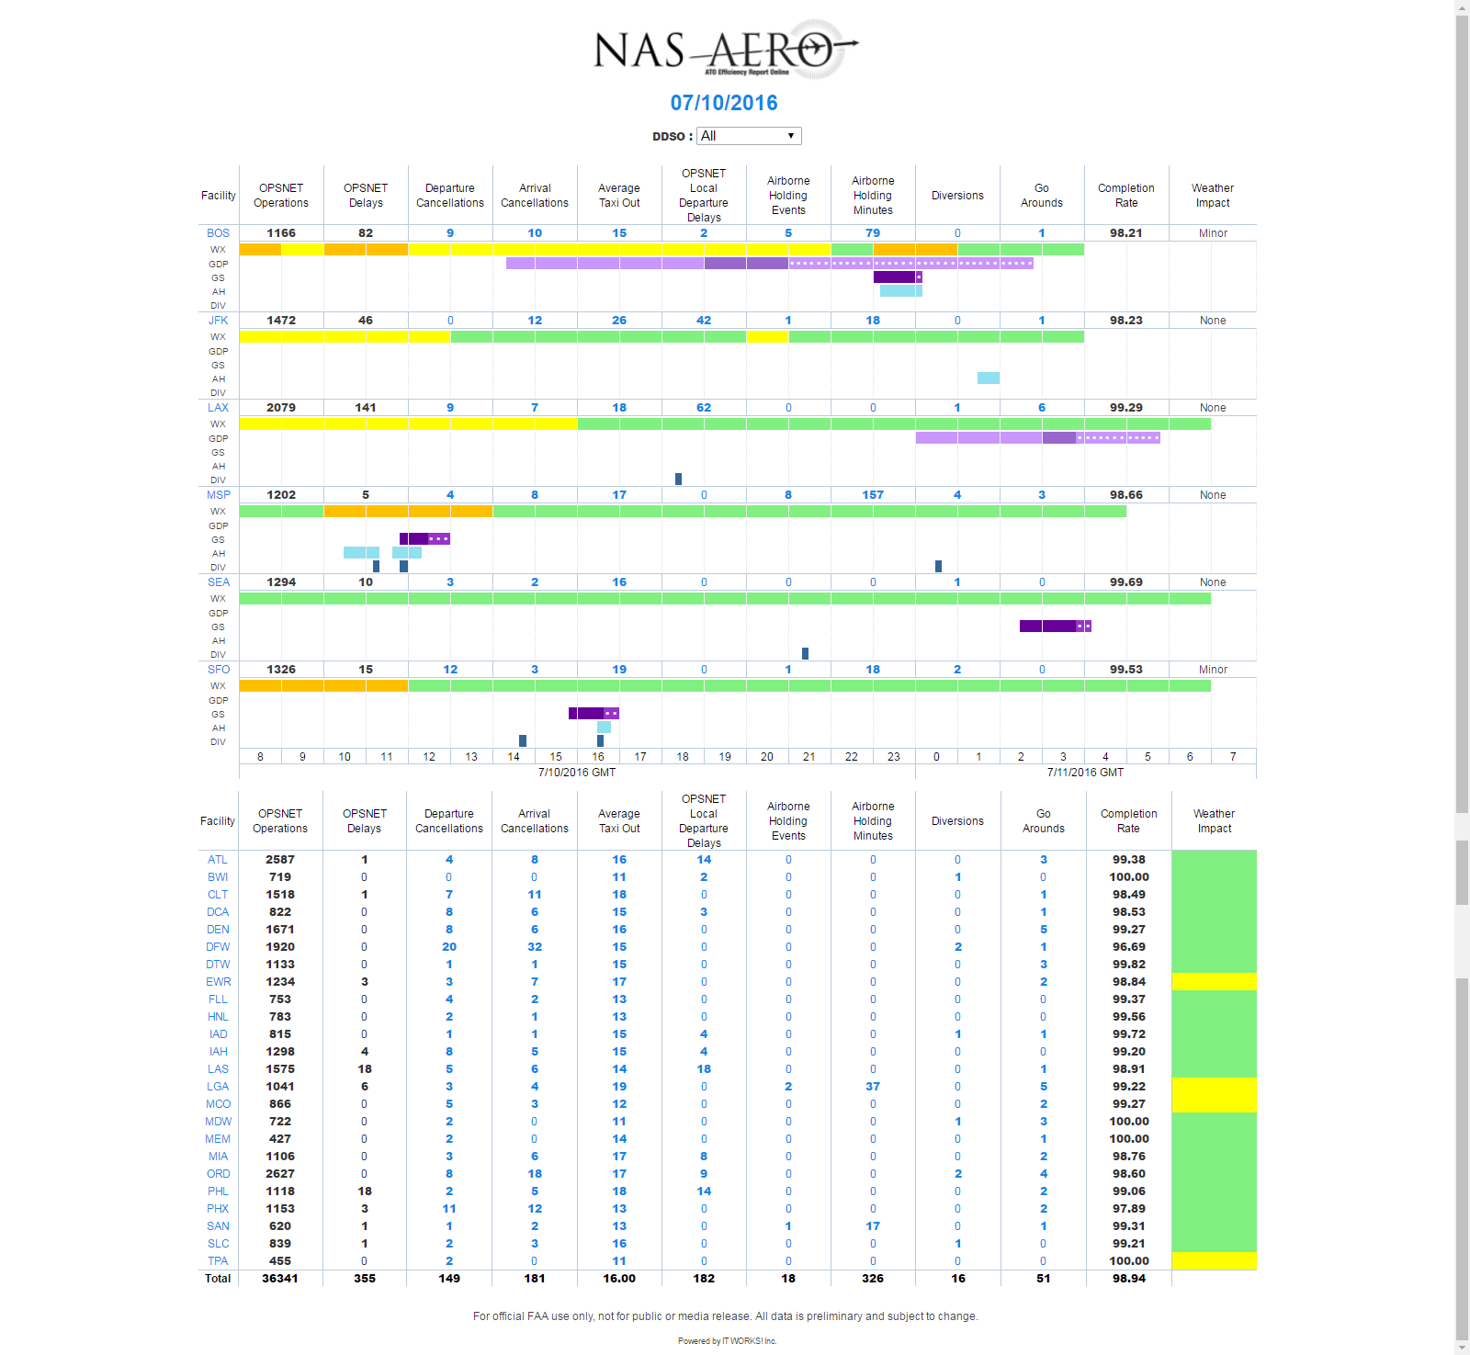
NAS AERO Lite
Quick Guide
NAS AERO Purpose:
Display Core Airport daily performance with context on one sheet
Separate focus areas from normal operation
NAS AERO Lite runs more quickly than the NAS AERO Full. It does not display historical baseline graphs which are included in the NAS AERO Report Full. Otherwise, the reports are identical.
NAS AERO context includes:
Historical baselines for each Core 30 Airport Key Performance Indicators (KPIs)
Timelines to show
Weather impact (WX)
Time and duration of Ground Stops (GS), and Ground Delay Programs (GDP)
Times Airborne Holding and Diversions occurred

Slide 2
NAS AERO Lite Focus Facilities
The top of the report re-formats and calls attention to Core Airports that had one or more of the following:
Implemented Ground Delay Programs or Ground Stops
Total Delays ≥ 25
Airborne Holding ≥ 15 Aircraft
Diversions ≥ 10 Aircraft
KPI Detail displays yesterday’s KPI value with hyperlink capability to display more detail.
24 hour timeline visually correlates Weather impact, GDP, GS, Airborne Holding, and Diversions.
Lighter shades of purple at the front or end of a GDP or GS indicate lead time or cancellation.
GMT hours are at the bottom

Slide 3
NAS AERO Lite Daily Stats
The bottom of the page describes the performance of Daily KPIs for each
Core Airport not pulled to the top of the page
Hyperlink to Facility Detail (AERO)
Daily KPIs
Mouse-over for the KPI Definition
KPIs are hyperlinked to more detailed charts/graphs
Aggregated Daily Weather Impact describes the total day’s weather impact as None, Mild, Moderate, or Severe. Individual hours are weighted by scheduled operations to calculate daily impact.

